Slide 1
Thursday, October 27, 2016
Write In Your Agenda:
Write In Your Monitoring Log:
CW:
Mercalli and Me!
HW:
None.
Response to Warm-Up:
What are the 3 scales used to measure earthquakes?
You will need:
Pencil
Plicker card

Slide 2
Learning Goal and Scale
TSW understand how the Earth’s natural processes have shaped its landscape (including Earthquake locations and how they are measured as well as Volcano locations and the three types).

Slide 3
How are the Effects Measured?
The Mercalli Scale measures the earthquake’s effects on a scale of 1-12 (in Roman Numerals). This is determined by scientists surveying the damage and then rating it on the scale. This scale is VERY subjective!
I: only detected by seismographs.
VI: felt by all, but very little damage
XII: causes total destruction.

Slide 4
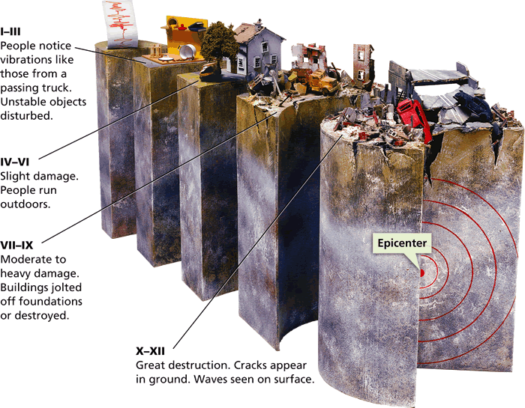
Measuring Earthquakes
The Mercalli scale was developed to rate earthquakes according to the amount of damage at a given place.

Slide 5
Mercalli & Me!
Work individually. However, you may talk about the activity with your peers at your table.
Complete the Eyewitness Account sheet.
Plot the Mercalli Scores on the map and follow the directions.
Complete the Reflection Questions.
Hand in when finished and work on An Inside Look At The San Andreas Fault.

